Slide 1


SafeMED
ROUTE OPTIMIZATION FOR PREVENTION OF STREET HARRASSMENT IN MEDELLIN

Slide 2



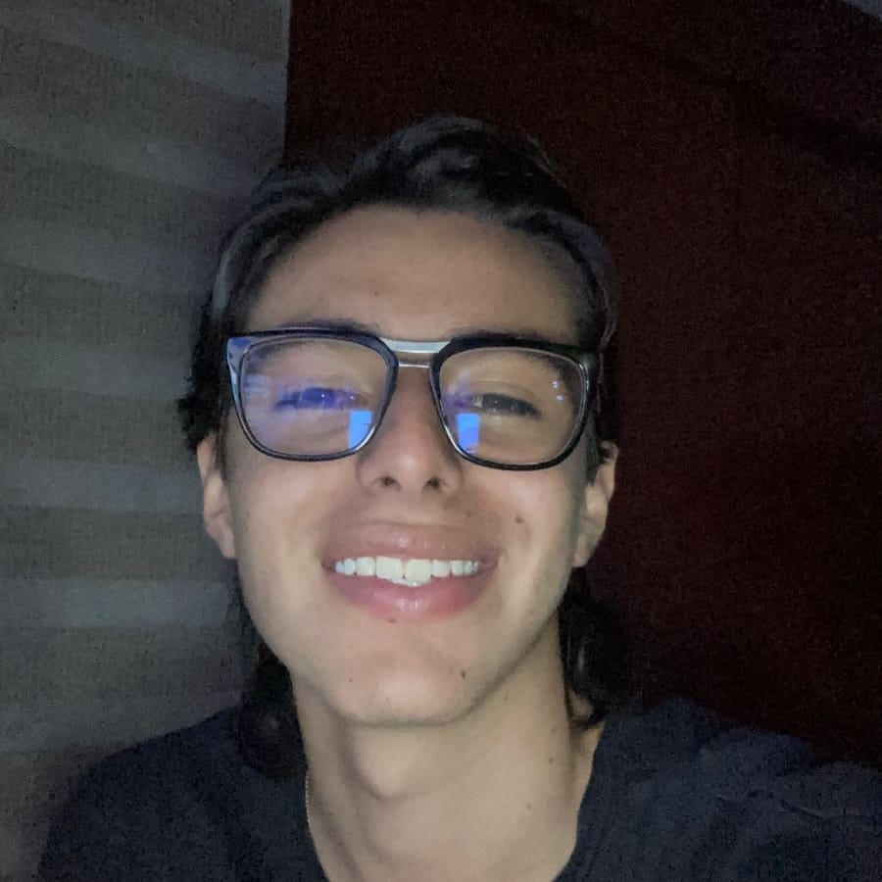


Our wonderful team!
Thomas Martinod
Leader
Emanuel Serna
Programmer
Andrea Serna
Literature reviewer
Mauricio Toro
Consultant
https://github.com/ThomasMartinod/SafeMED/

Slide 3
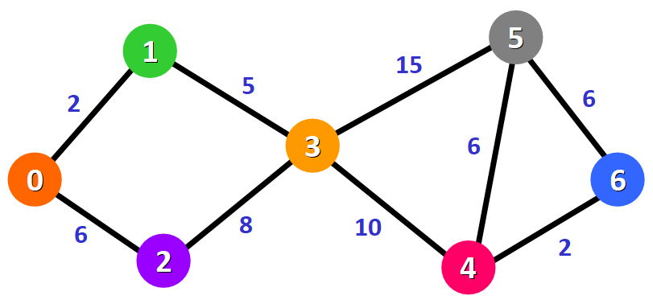
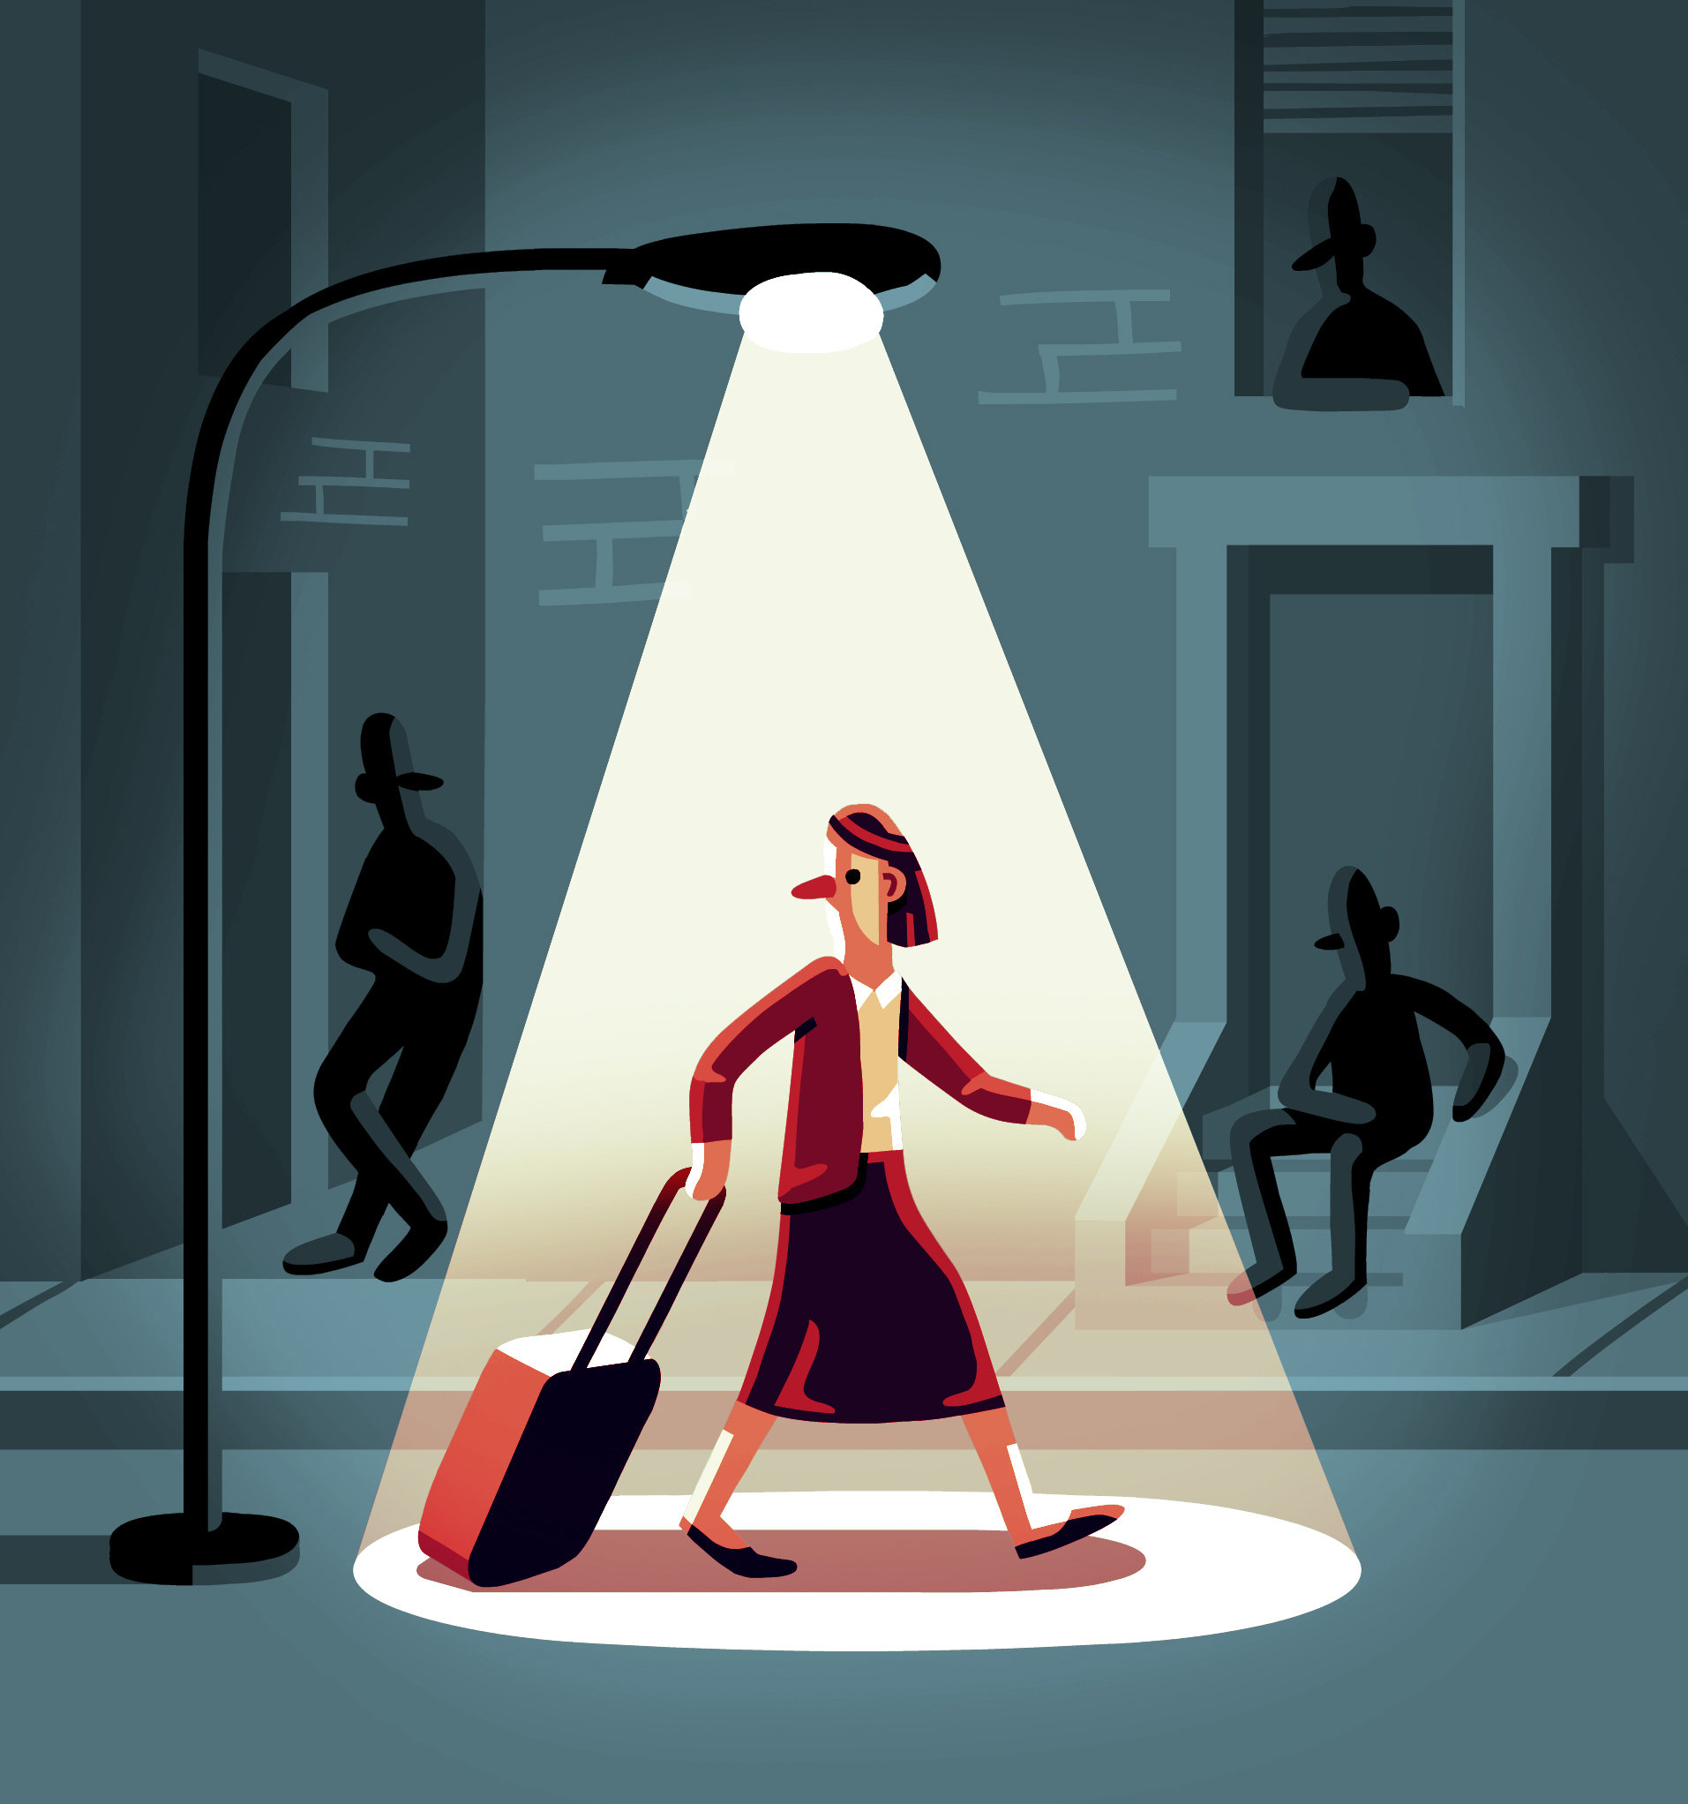
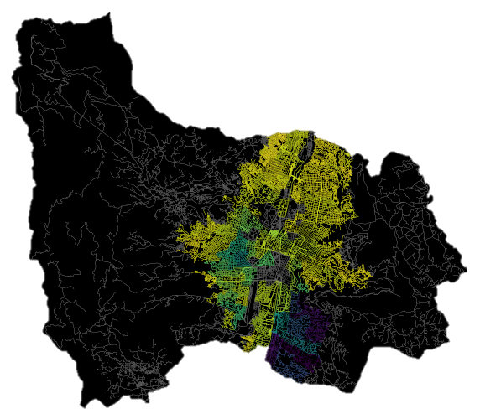
Problem to solve

Slide 4
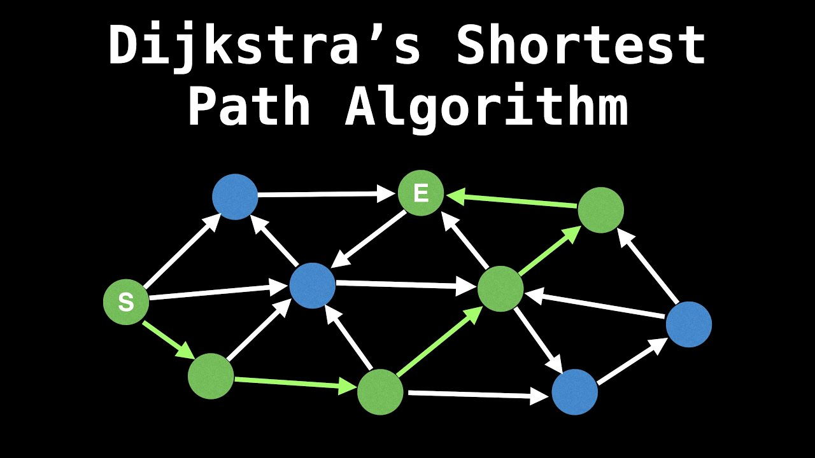
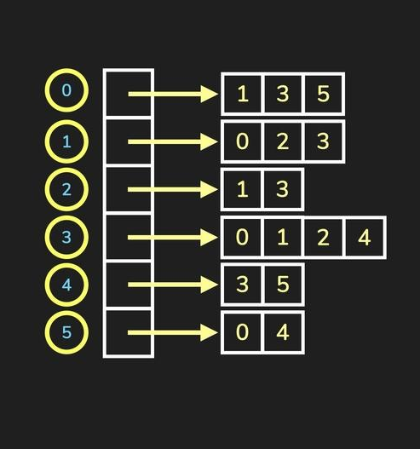
Implemented algorithm

Slide 5



Combining distance and harassment risk
First Path,
$$PathValue=\left(\frac{1}{2}\right)∗distance+(100∗harassmentRisk)$$
Our Soultion

Slide 6


Combining distance and harassment risk
Second Path,
$$PathValue=100∗distance+100∗harassmentRisk$$
Minimal distance
Third Path,
Another great path
$$PathValue={distance}^{harassmentRisk}$$

Slide 7
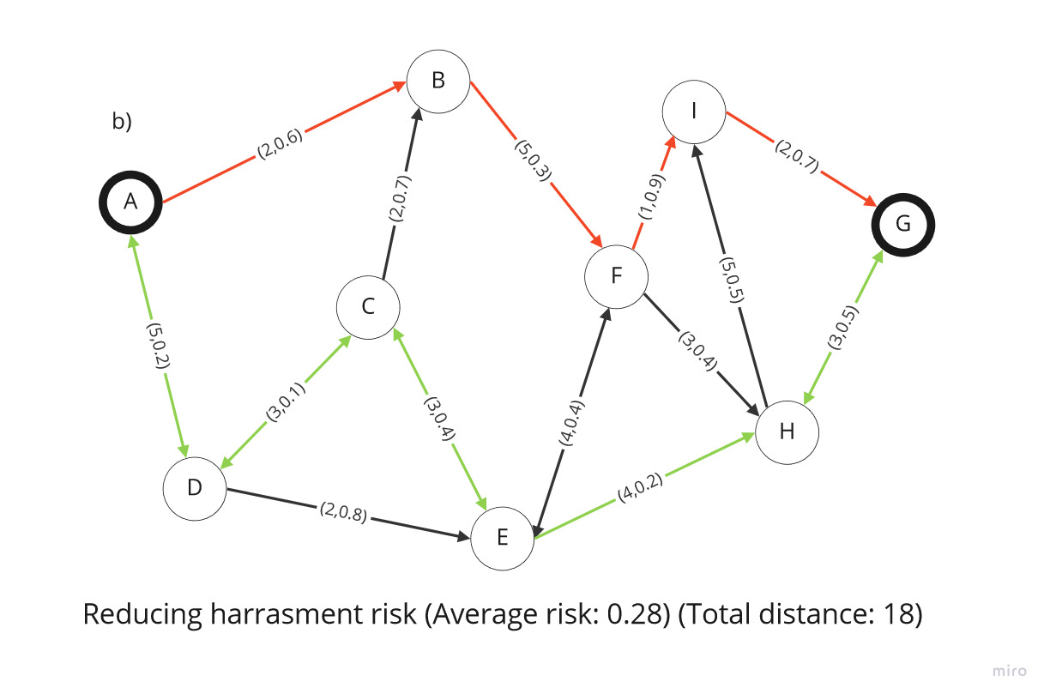
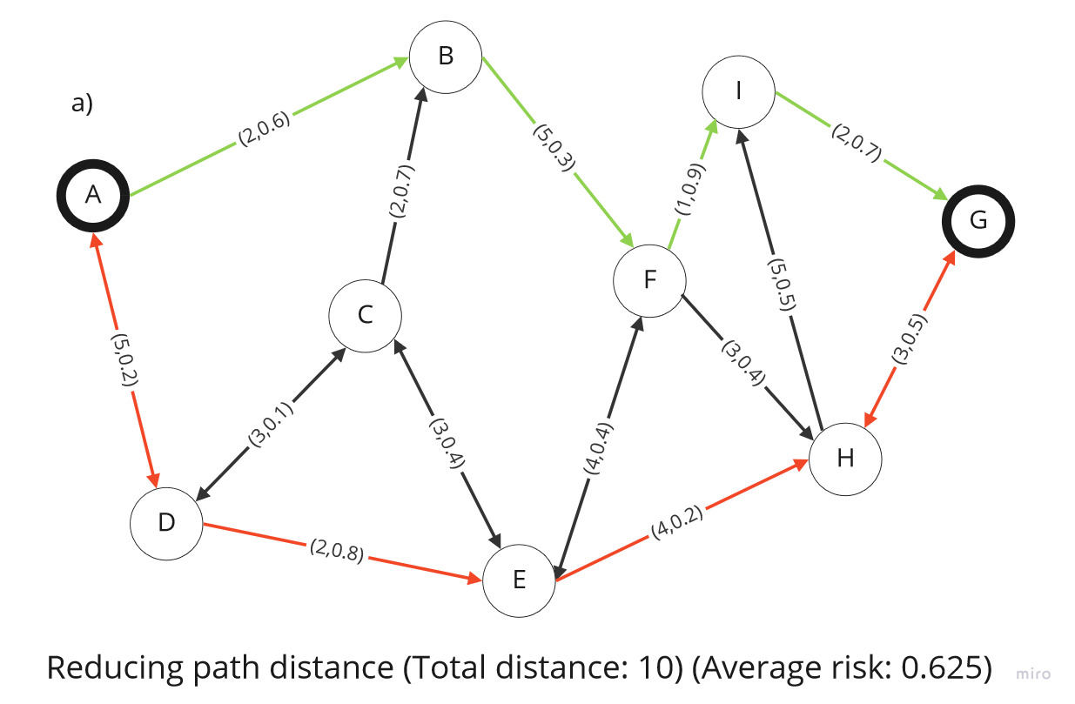
Explaining our solution, Dijkstra’s algorithm
https://github.com/ThomasMartinod/SafeMED/

Slide 8
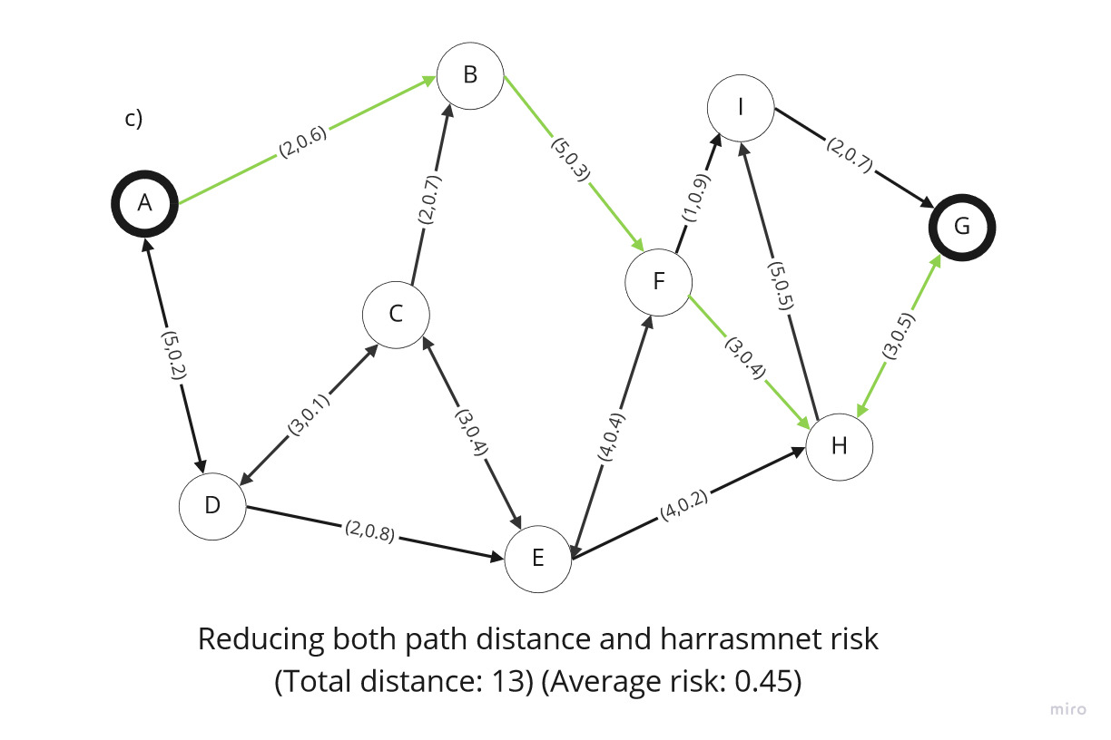
Dijkstra’s algorithm
https://github.com/ThomasMartinod/SafeMED/

Slide 9

Complexity of the algorithm
 | Time complexity | Complexity of memory
Graph Creation | O(V) | O(V)
Dijkstra’s Algorithm | O(E + V*log(V)) | O(V²)
Where V represents the number of vertices in the graph (total individual coordinates considered in the database), and E represents the edges of the graph (total streets of Medellín).

Slide 10



First path
Origin | Destination | Distance (meters) | Risk of harassment (between 0 and 1)
EAFIT University | National University | 8969.40 | 0.53
Data structures,
Average Runtime, 0.0488s

Slide 11
Second path
Origin | Destination | Distance (meters) | Risk of harassment (between 0 and 1)
EAFIT University | National University | 8574.13 | 0.69
Average Runtime, 0.0317s

Slide 12
Third path
Origin | Destination | Distance (meters) | Risk of harassment (between 0 and 1)
EAFIT University | National University | 9061.75 | 0.58
Average Runtime, 0.0557s

Slide 13
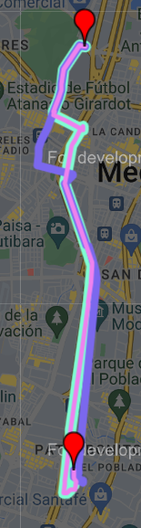
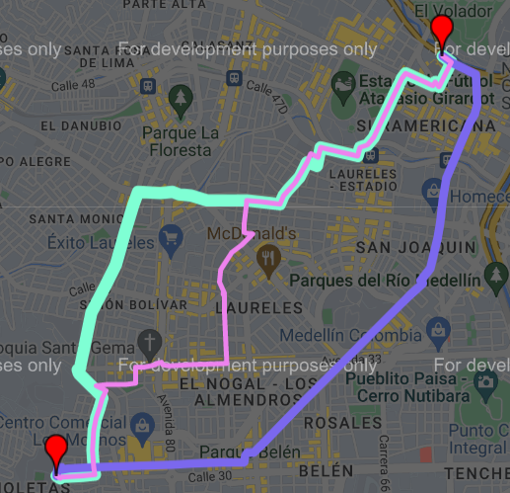
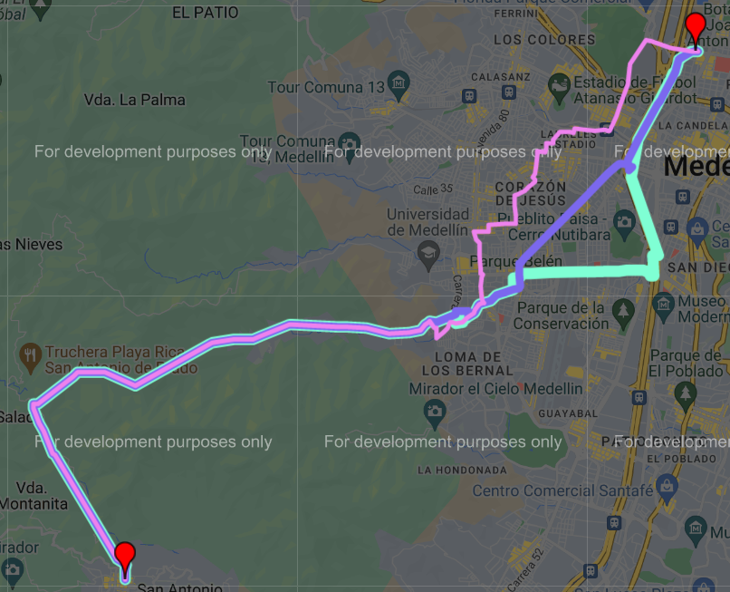
Visual comparison of the three paths
EAFIT -> UNAL
LuisAmigó -> UdeMedellín
San Antonio de Prado -> UdeA

Slide 14

Future work directions
Probability
Optimization 1
Statistics 2
M & S 4
Other risk estimates
Complexity reduction on less roads
MV risk estimates
Time modelling

Slide 15

THANK YOU!!!
With the support of
Isabel Mora and Juliana Velez

